Slide 1
CSE 472 (Machine Learning Sessional)
Project Presentation
Supervisor - Dr. Mohammed Eunus Ali
1705039 - Tahmeed Tarek
1705044 - Najibul Haque Sarker
A2 - Group 9

Slide 2
Introducing self cross-attention in transformer-based architectures for phrase-to-phrase matching

Slide 3
Goals
The main focus on this project would be
Perform a modification to transformer architecture and test it on popular NLP tasks e.g. semantic similarity
Explore possible downstream application of the model trained on semantic similarity task

Slide 4
1. Novel changes in architecture self cross-attention

Slide 5
Similarity Model Baseline
Compare accuracy scores against baselines - BERT/ DeBERTa
Scores in Phrase 2 Phrase Dataset

Slide 6
Baseline Scores
Model | Pearson correlation coefficient (PCC)
Bert Large | 0.8487
Deberta Large | 0.8505
Training: 27,354 examples
Testing : 9,119 examples
Epochs : 15
Input : [anchor] + <SEP> + [target]
Head : 1 Attention + 1 Dense Layer

Slide 7
Modifications
Compare accuracy scores against baselines - BERT (modifications)
Scores in Patent Dataset

Slide 8
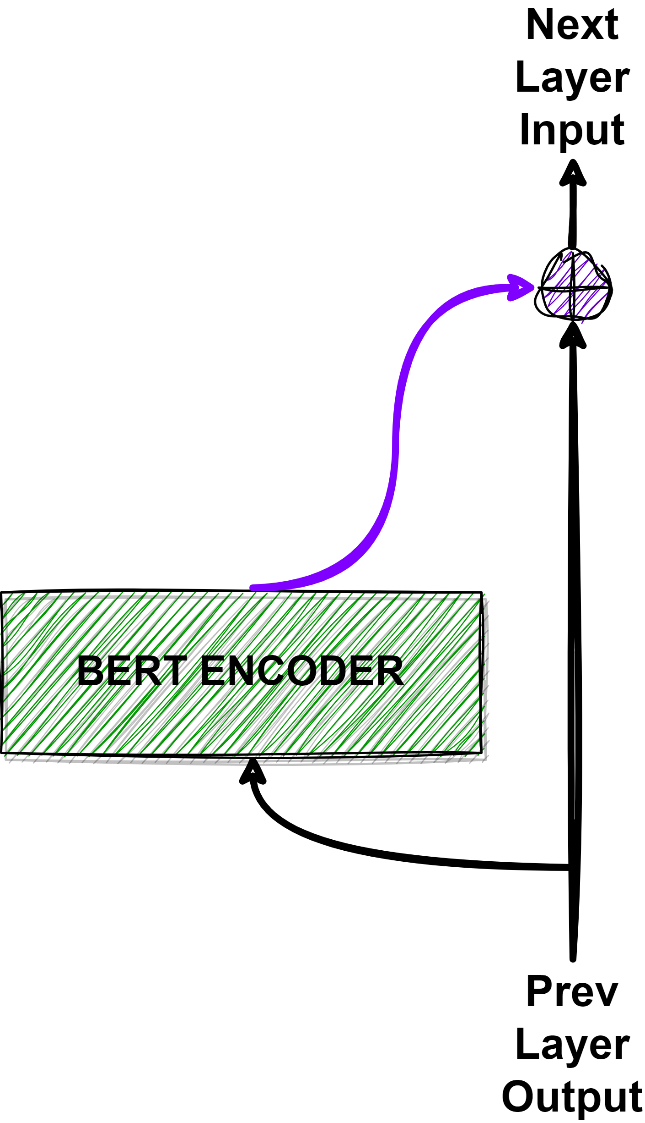
Original
Output of previous layer is added with the Bert Encoder output with a residual connection
Intuition: There should be feature representation discrepency, so directly using residual connection might have adverse effect

Slide 9
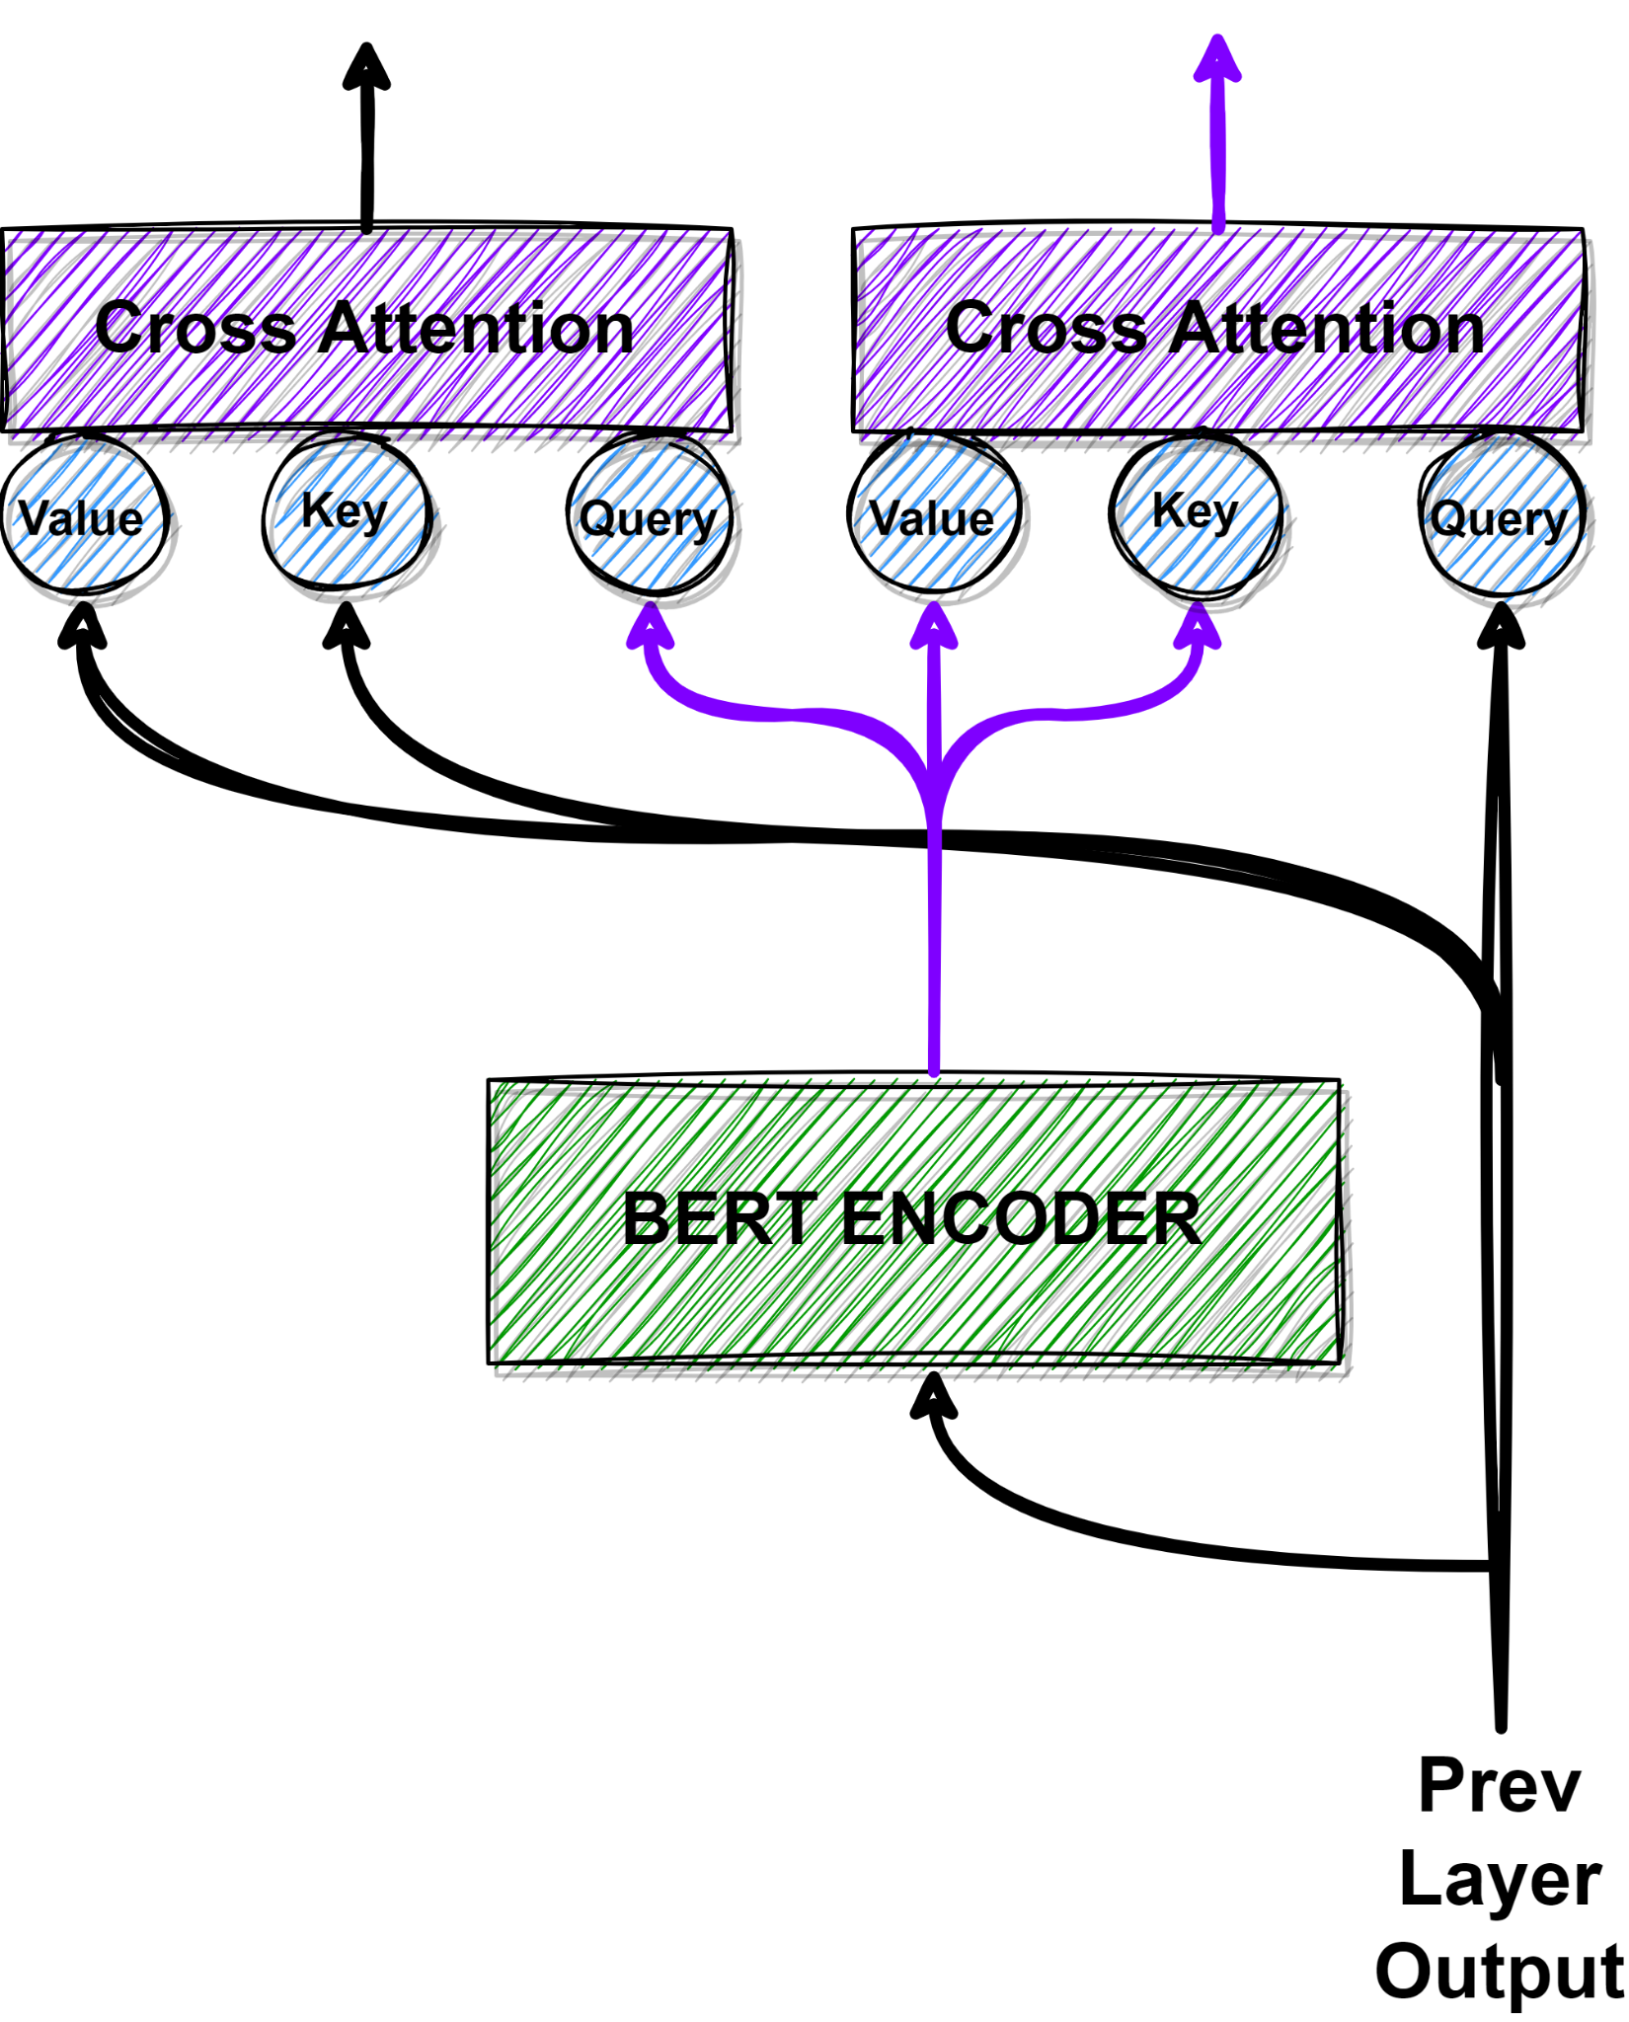
Modification
Cross Attend Previous Layer Output and Current Layer Bert Encoder Output

Slide 10
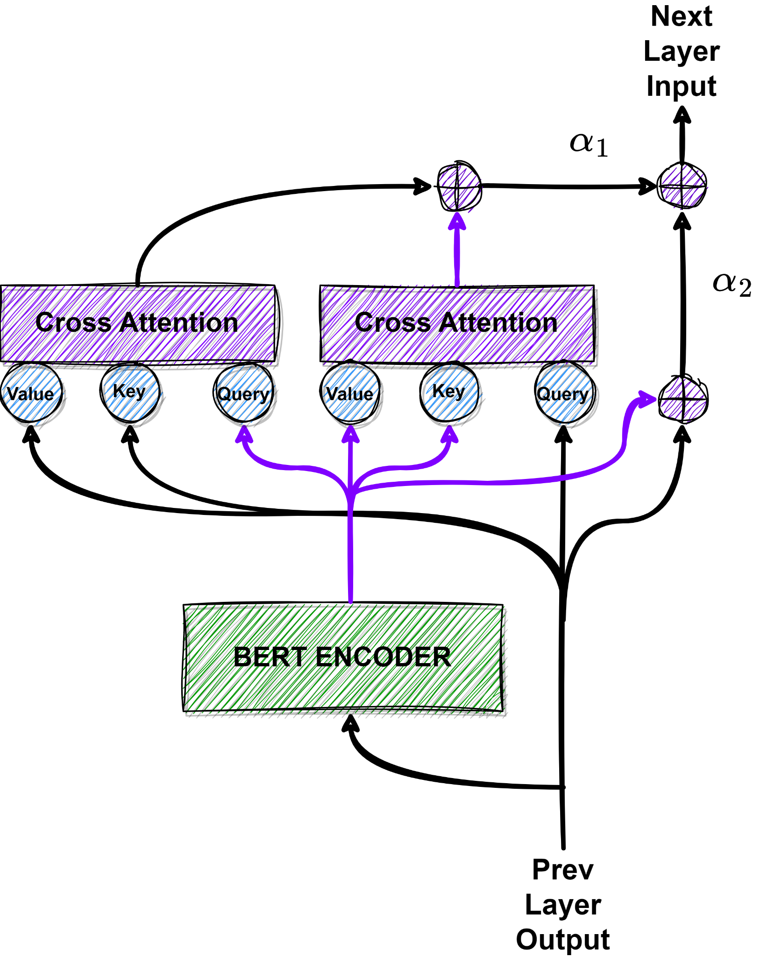
Modification
Cross Attend Previous Layer Output and Current Layer Bert Encoder Output
Trainable weighted summation of original residual connection and cross attended output

Slide 11
Modification
New Cross Attended Residual Connection
Cross Attend Previous Layer Output and Current Layer Bert Encoder Output
Trainable weighted summation of original residual connection and cross attended output
Previous Residual Connection

Slide 12
Modification Scores (Prev Update)
Model | Pearson correlation coefficient (PCC)
Bert Large | 0.8487
Modified Bert (in middle and last layer) | 0.8426
Modified Bert (in middle and last layer) (Freeze other params for 3 epochs) | 0.8506
Modified Bert (from middle to last layer) (Freeze other params for 3 epochs) | 0.8442
Here, Initialize alpha1 = 0.50, alpha2 = 0.50
Tuned this to alpha1 = 0.10, alpha2 = 0.90 -> next experiments

Slide 13
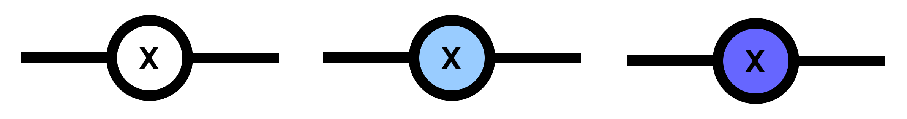
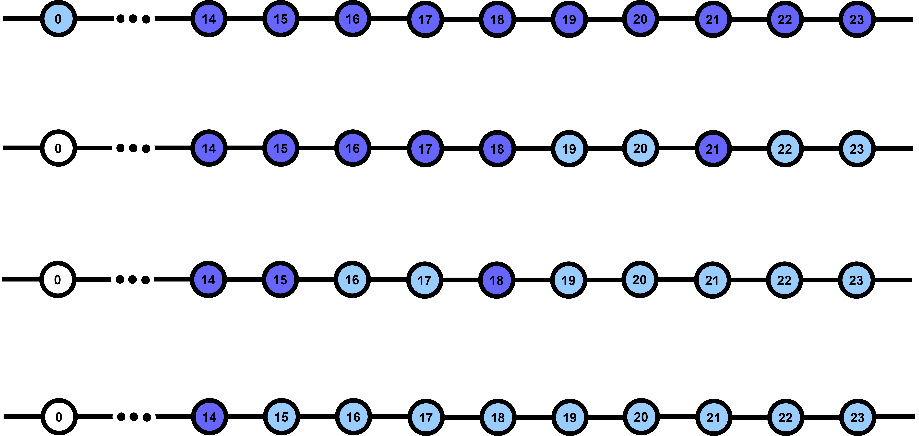
Modification Scores
NO SC Layer
Has SC Layer,
But α₁ < threshold
Has SC Layer,
But α_{1 >} threshold,
Use in next exp
Bert Layers
SCORES
0.8497
0.8518
0.8487
0.8511

Slide 14
Modification Scores
NO SC Layer
Has SC Layer,
But α₁ < threshold
Has SC Layer,
But α_{1 >} threshold,
Use in next exp
Bert Layers
SCORES
0.8497
0.8518
0.8487
0.8511

Slide 15
Final Model Scores
Model | Pearson correlation coefficient (PCC)
Bert Large | 0.8487
Deberta Large | 0.8505
Bert Large with Self Cross Attention | 0.8518

Slide 16
2. Full Pipeline for Semantic Similarity Score keyword extraction semantic score comparison with sentence transformer

Slide 17
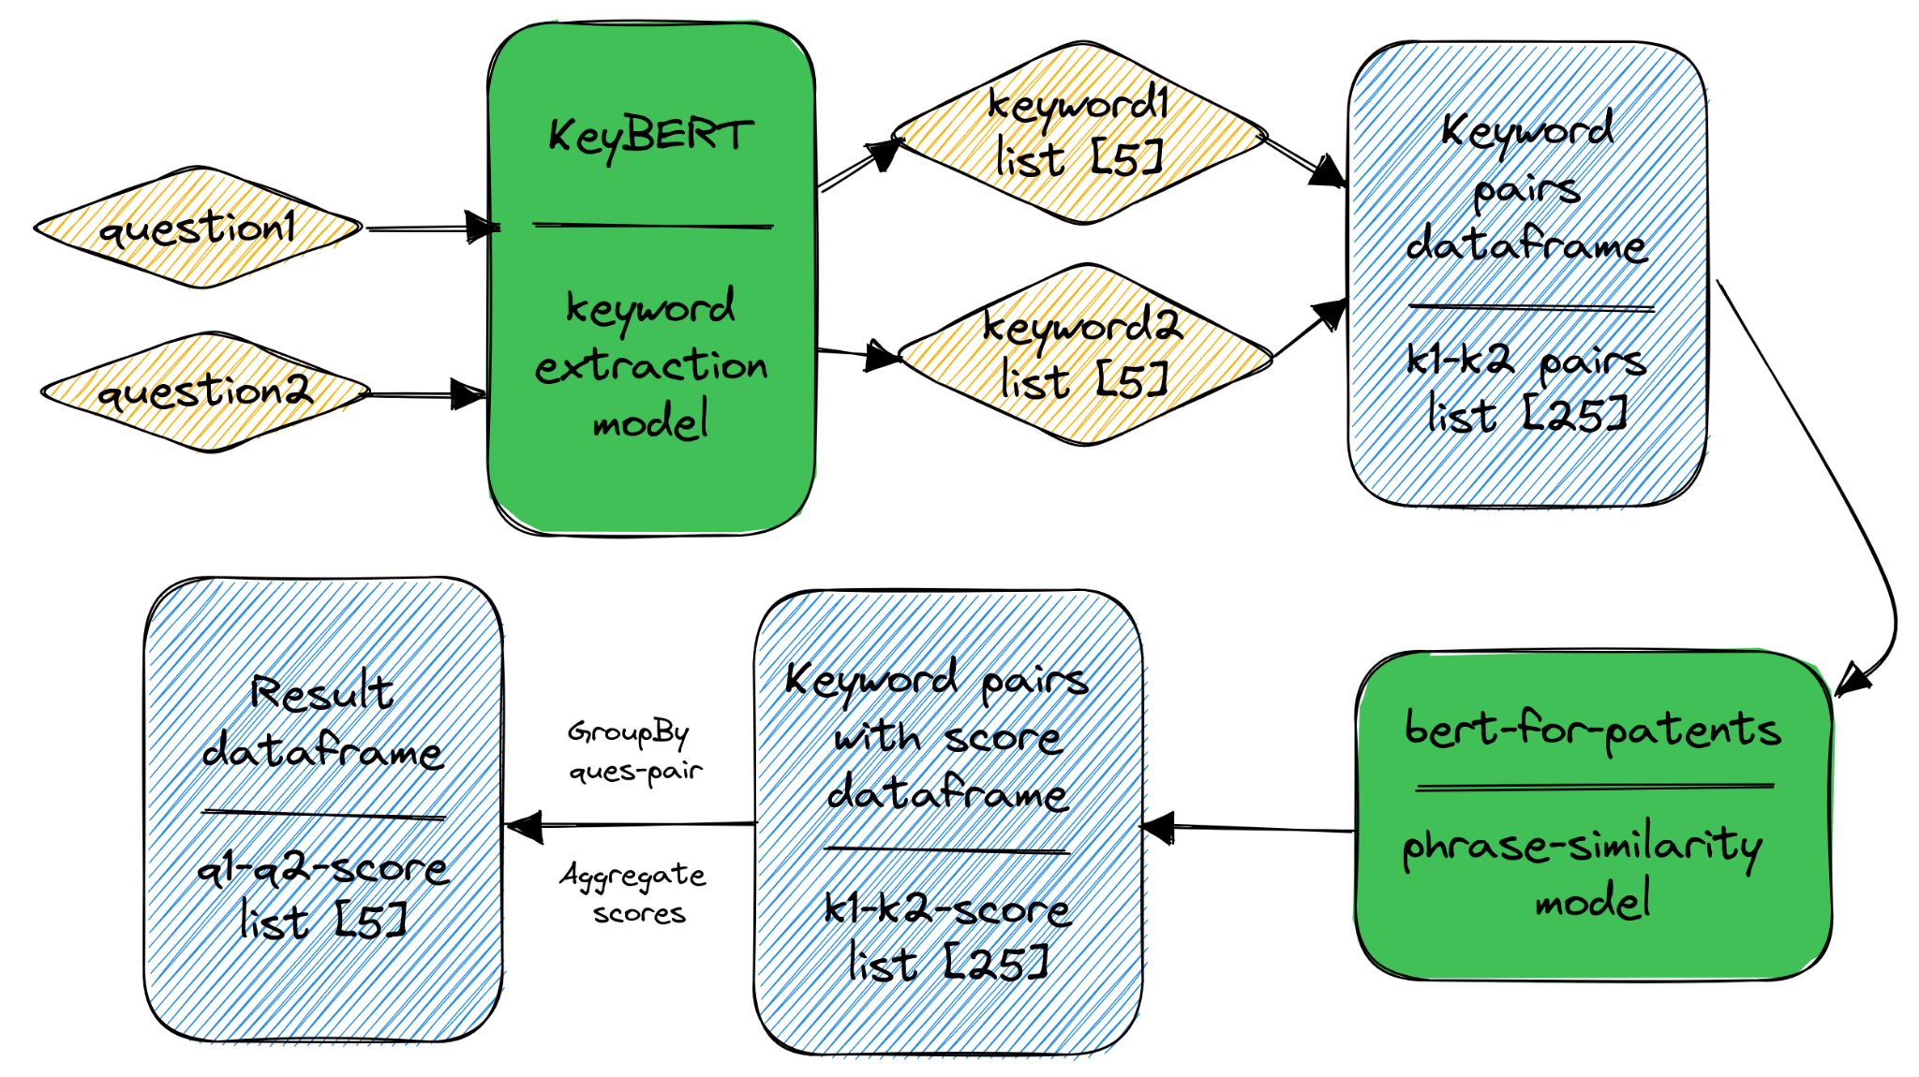
P
I
P
E
L
I
N
E (prev)

Slide 18
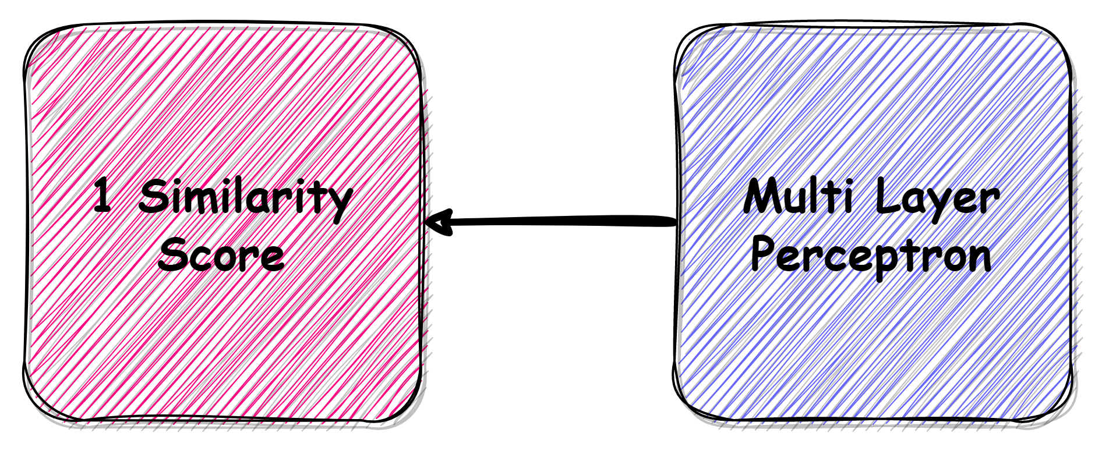
P
I
P
E
L
I
N
E (curr)

Slide 19
Keyword Extraction
Extract keywords from sentences

Slide 20
Keyword Extraction
KeyBERT - https://github.com/MaartenGr/KeyBERT
Uses BERT-embeddings & simple cosine similarity
Example:
Sentence: What is the step by step guide to invest in share market in india?
([('invest share', 0.6415), ('share market', 0.6207), ('guide invest', 0.5644), ('market india', 0.5642), ('invest', 0.5359)]

Slide 21
Multi Layer Perceptron
Get final score from Bert Phase2Phase model outputs

Slide 22
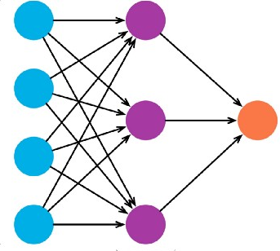
Multi Layer Perceptron
For each input 5 phrases will be extracted
Need to find 5x5 or 25 phrase similarity scores
So, BERT outputs 25 scores for each pair
MLP takes this 25 scores as input
Outputs 1 similarity score

Slide 23
How to Evaluate Full Pipeline?

Slide 24
Pipeline Evaluation
Use Quora Question Pair Dataset
But they only have 1 label: Duplicate or not
How to change to similarity scores?
Use pretrained sentence transformer to generate labels
We now have similarity scores for Quora QP dataset and can use as ground truth for pipeline evaluation

Slide 25
Sentence Transformer
Generate labels for Quora QP Dataset

Slide 26
Sentence Transformer
https://www.sbert.net/docs/pretrained_models.html
Extract embeddings between 2 sentences
Measure similarity by the cosine similarity distance between embeddings

Slide 27
Pipeline Results
Compare scores between models
Scores in Quora Question Pair Dataset

Slide 28
P
I
P
E
L
I
N
E (curr)

Slide 29
Why MLP?
Model | Mean Absolute Error (MAE)
Top5 mean | 0.142
XGBoost | 0.1133
Support Vector Regressor | 0.1185
Random Forest Regressor | 0.1140
MLP | 0.1126
Using Quora 20k samples with vanilla BERT phase2phase outputs

Slide 30
Full Pipeline Scores
Model | Pearson correlation coefficient (PCC) Phrase2Phrase | Mean Absolute Error (MAE) Quora QP
Bert Large | 0.8487 | 0.1097
Deberta Large | 0.8505 | 0.1004
Bert Large with Self Cross Attention | 0.8518 | 0.1092

Slide 31
Example using paper abstracts
Example1: Attention is all you need abstract
Example2: Rephrased example1 via chatgpt
Example3: Deep Residual Learning for Image Recognition abstract
Q1 | Q2 | Sentence Transformer | Top5 Mean | MLP
Example1 | Example2 | 0.9887 | 0.9994 | 0.9754
Example1 | Example3 | 0.5417 | 0.3025 | 0.3838
Example2 | Example3 | 0.5493 | 0.2973 | 0.3874

Slide 32
Contributions
Tahmeed | Najib
Literature Review | 0.8487
Dataset Search & Build Solution | 0.8505
Phrase2phrase Train & Infer (Deberta) | Phrase2phrase Train & Infer(Bert)
KeyBert | Self Cross Attention Bert
Sentence Transformer
Post Process Experiments (MLP)

Slide 33
A2 - Group 9
1705039 - Tahmeed Tarek 1705044 - Najibul Haque Sarker
Thank You

